Slide 1
Emergency Management for Elected Officials
Berks County Department of Emergency Services
DirectLink Technology Center
2561 Bernville Road
Reading, PA 19605
(610) 374-4800 – Phone
(610) 374-8865 – Fax
berksdes@berkspa.gov
http://www.berksdes.com

Slide 2
Course Overview
Basics of Emergency Management
State & Federal Laws
Responsibilities of the Elected Official
Disaster Assistance
Continuity of Government
NIMS & ICS

Slide 3
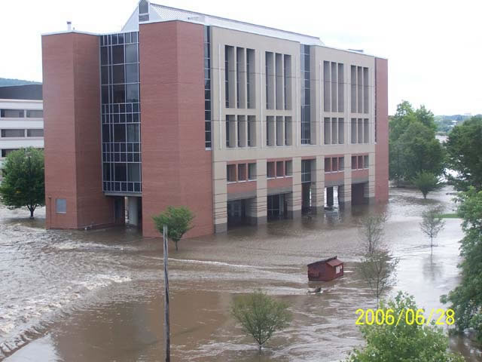
What does “Emergency Management” mean to you?
Notes:
RACC

Slide 4
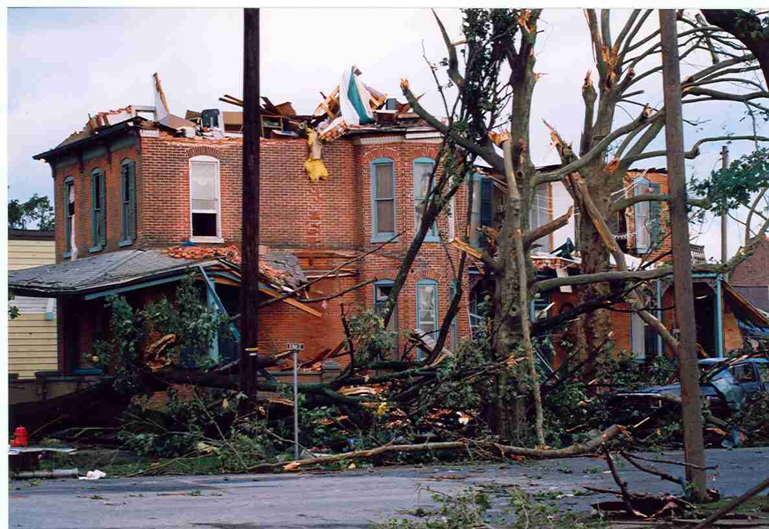
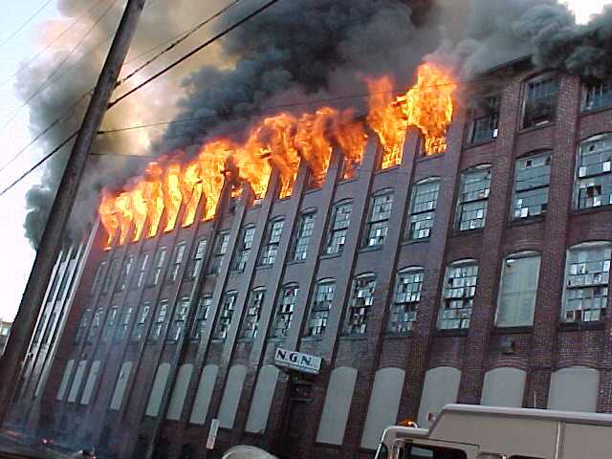
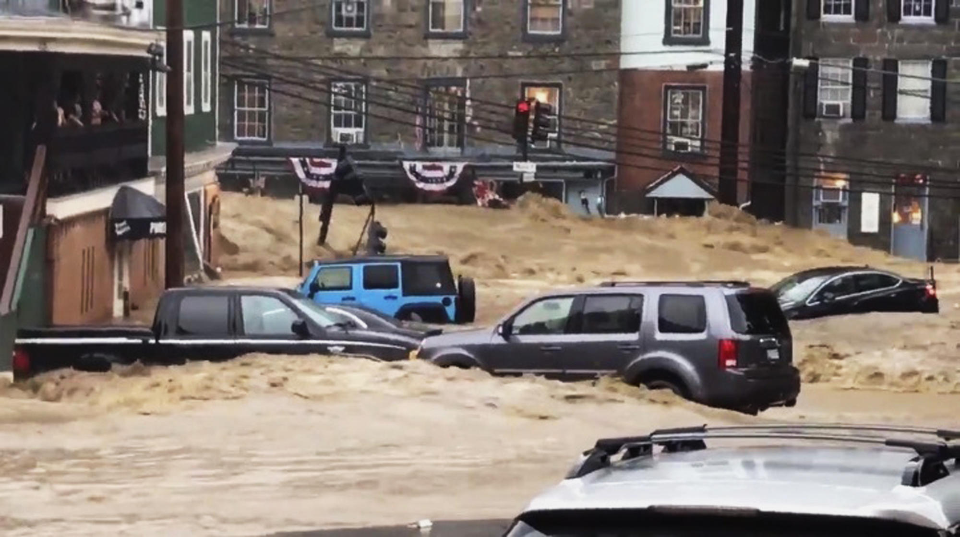

Slide 5

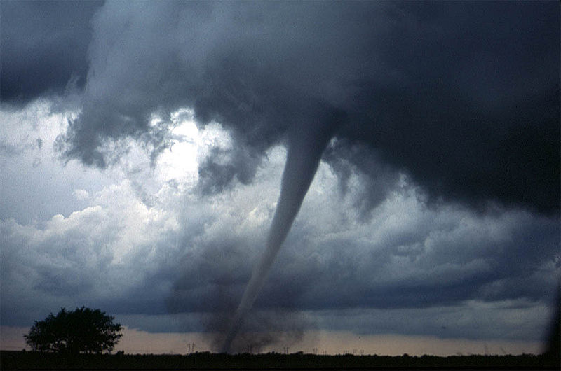

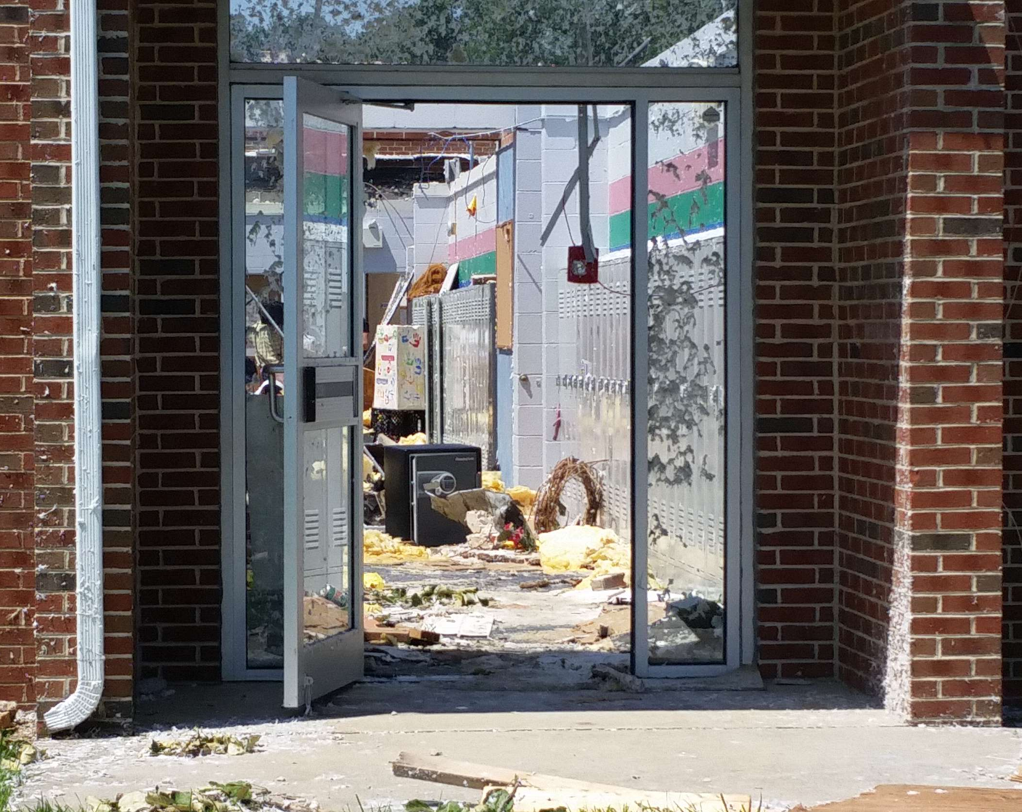

Slide 6
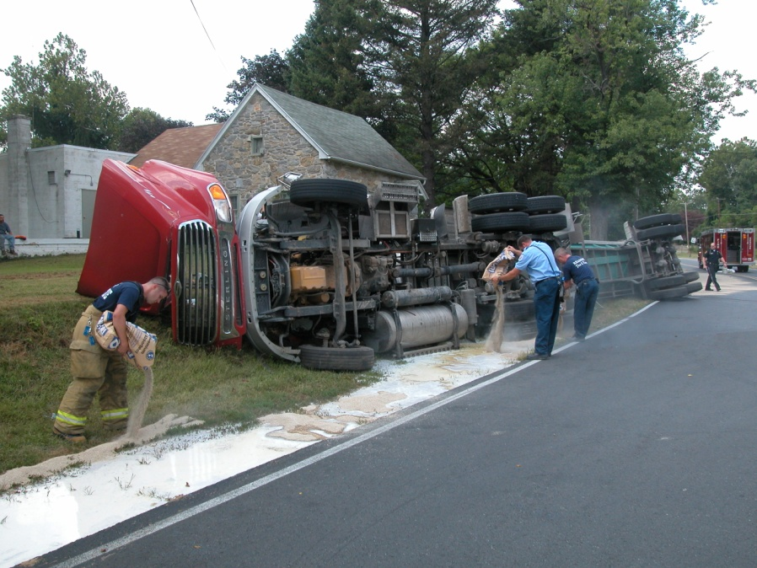
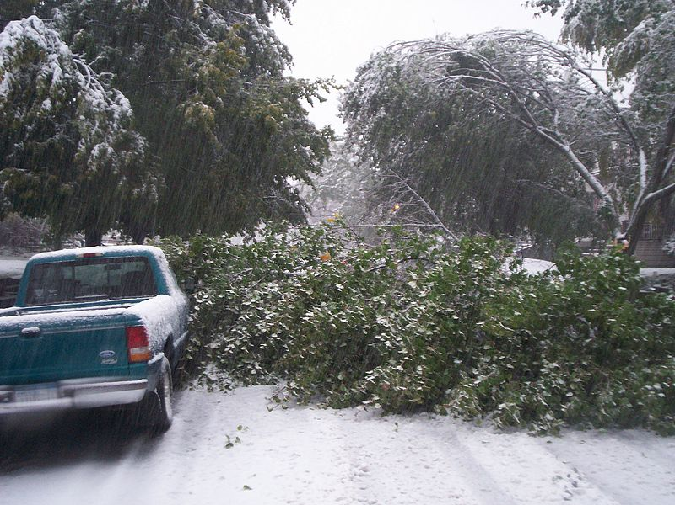


Slide 7
Emergency Management Is...
The process of dealing with extreme events that can disrupt communities, cause extensive damage or affect a large number of people.

Slide 8
What Types of Disasters Could Impact your Municipal Operations?

Slide 9
Berks County Hazards
Civil Disorder
Dam Failure
Drought
Earthquakes
Flooding
Hazardous Materials
Hurricanes
Land Subsidence
Landslides
Nuclear Power Plant
Power Failure
Public Health Emergency
Radon
Severe Winter Weather
Terrorism
Tornadoes
Transportation Accidents
Urban Fires
Wildfires
Notes:
Opportunity to discuss BERKS County HMP

Slide 10
Recommending an Emergency Management Coordinator is one of the primary responsibilities of the Elected Officials.
What type of person do you think would make a good EMC?

Slide 11
What to look for in an EMC
Planning & Training Skills
Administrative Skills
Multi-Tasker
Emergency Service Experience?
Education
Capability
Experience
Motivator/Motivated
Communicator
Decision Maker
Time Manager
Leader

Slide 12
Duties & Responsibilities of the EMC
Prepare & maintain the Emergency Operation Plan
Manage the Emergency Operations Center
Recommend mitigation measures
Provide prompt & accurate information to the county
Participate in drills, exercises, and training
  PEMA training directive 2022-02
Notes:
Review and Update of municipal EOPs every two years.

Slide 13
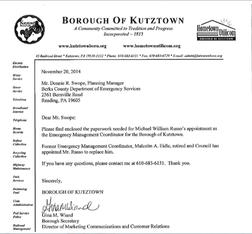
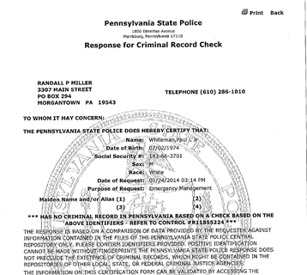
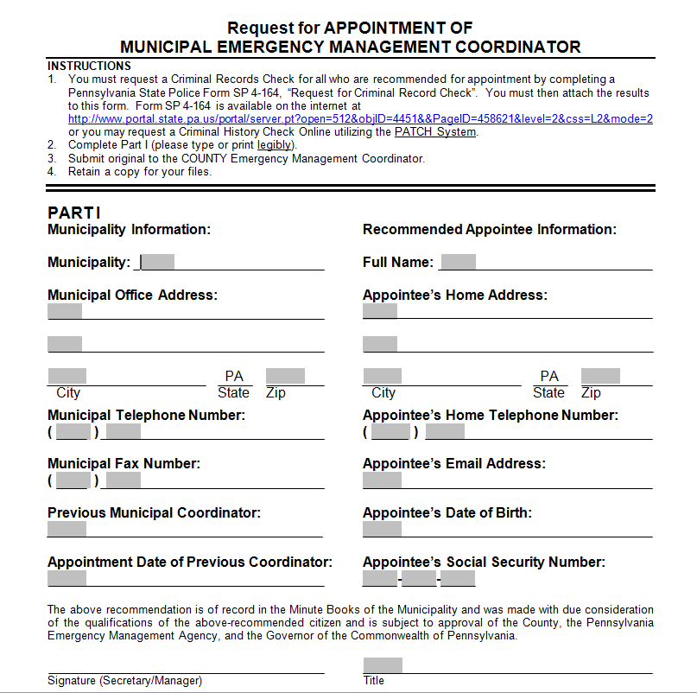
Notes:
Discuss the process and what is needed prior to submitting to PEMA for Governor appointment.

Slide 14
The Phases of Emergency Management
Prevention
Mitigation
Preparedness
Recovery
Response

Slide 15
Prevention
Actions taken to avoid an incident or to intervene to stop an incident from occurring.

Slide 16
Mitigation
Preventative actions taken to minimize the loss of life and property during a disaster.
What are some examples of mitigation actions?
Notes:
One of the most overlooked phases
Give some examples of mitigation activities & Explain the Six Mitigation Types
Preventative Measures – Land use / Building / Zoning Laws / Floodplain Regulations
Emergency Service Measures – Hazard Warning / Hazard Response
Property Protection Measures – Elevation / Floodproofing / Relocation
Structural Projects – Dams / Firebreaks / Storm water drainage
Natural Resource Protection – Open Space & Wetland Preservation
Public Information – Outreach projects / Resources on website / Library

Slide 17
Preparedness
Measures that prepare responding forces and citizens to take prompt, appropriate action in the event of an emergency.
What are some examples of preparedness actions?
Notes:
What are some examples of preparedness activities?
PLAN DEVELOPMENT
TRAINING
EXERCISES
RESOURCE IDENTIFICATION

Slide 18
Response
Activities taken in an emergency to save lives and prevent harm to people and property.
What are some examples of response activities?
Notes:
The most stressful phase
If we actively address the other three phases, the response phase may not be as stressful!

Slide 19
Recovery
Activities that restore property and systems to their normal condition before the event occurred.
What are some examples of recovery actions?
Notes:
RECOVERY FUNCTIONAL AREAS
BUSINESS
DAMAGE ASSESSMENT
DEBRIS MANAGEMENT
ENVIRONMENTAL
HISTORICAL / CULTURAL
HOUSING
CRITICAL INFRASTRUCTURE
PUBLIC SECTOR
SOCIAL / PSYCHOLOGICAL
RECOVERY CAN TAKE 10X THE RESPONSE PHASE – 3 DAY RESPONSE – 30 DAY RECOVERY
LONG TERM RECOVERY CAN TAKE 100X THE RESPONSE PHASE – 3 DAY RESPONSE – 300 DAY RECOVERY

Slide 20




Levels of Emergency
Management
Municipal
County
Regional
State
Federal

Slide 21




Municipal EMA
Incident starts at this level.
Response time is immediate.
Self-sustaining until requested assistance arrives.

Slide 22
County EMA
Beyond the municipality’s capability.
Encompasses more than one municipality.
Response Time – 1 hr.
Provides extra, but limited resources.
Hazardous Materials involved.

Slide 23

Regional
Collaboration of County EMAs
Southeastern PA Task Force
Provide human and physical resources
Bucks
Chester
Delaware
Montgomery
Philadelphia
Berks
Notes:
RESOURCES AVAILABLE TO MEMBER COUNTIES OF ECPATF INCLUDE IMT, HAZ MAT, BOMB SQUAD, PHYSICAL RESOURCES THAT INDIVIDUAL EMAS HAVE.

Slide 24


State EMA
Incident is beyond the county’s capability.
Incident encompasses more than one county.
Response Time – 4 hr.
Provides additional resources.

Slide 25

Federal EMA
Incident beyond the state’s capability.
Incident encompasses more than one state.
Response Time – Various.
Provides additional resources.

Slide 26
Emergency Management Legislation
Federal Laws
  Robert T. Stafford Act
  SARA Title III
  Homeland Security Act of 2002
  Disaster Mitigation Act of 2000
  PETS Act of 2006
Commonwealth Laws
  Act 78
  Act 147
  Act 165
  Act 227
  Title 35
Notes:
ROBERT STAFFORD – UPDATED CIVIL DEFENSE ACT, ESTABLISHES LOANS AND GRANTS
SARA TITLE III – ESTABLISHES FEES FOR HAZ MAT PRODUCTION AND USAGE
HOMELAND SECURITY ACT OF 2002 – ESTABLISHED DHS
DISASTER MITIGATION ACT OF 2000 – AMMENDED STAFFORD ACT AND ADDED REQUIREMENTS OF HAZARD MIT PLANS.
PETS ACT OF 2006 – AMMENDED STAFFORD ACT AND REQUIRED EOPS ADDRESSED RESCUE AND SHELTERING OF DOMESTIC ANIMALS.
ACT 165 – HAZ MAT EMERGENCY PLANNING & RESPONSE – LEPC, TIER II, SARA
ACT 147 – PA RADIATION PROTECTION ACT – MISC. RAD REQUIREMENTS
ACT 78 – PUBLIC SAFETY EMERGENCY TELEPHONE ACT - 911

Slide 27
Title 35
Emergency Management Services Code
Establishes state and local EMAs
Specifies requirements of same

Slide 28
Components of Title 35
Chapter 71 – General Provisions
Chapter 73 – Commonwealth Services
Chapter 75 – Local Organizations and Services
Chapter 76 – Emergency Management Assistance Compact
Chapter 77 – Miscellaneous Provisions
Notes:
Chapter 71 – General Provisions
Provides definitions of terms & general information on act
Chapter 73 – Commonwealth Services
Specifies duties and responsibilities of PEMA and other state agencies, emergency powers granted to governor, direct and compel evacuation, prepare and maintain state EOP, establish state EOC.
Chapter 75 – Local Organizations and Services
Compensation for injury, interstate arrangements, regulations applicable to schools
Chapter 76 – Emergency Management Assistance Compact
Chapter 77 – Miscellaneous Provisions

Slide 29
Chapter 75 Highlights
§ 7501 – General Authority of Political Subdivisions
§ 7502 – Local Coordinator of Emergency Management
§ 7503 – Powers and Duties of Political Subdivisions
§ 7504 – Coordination, Assistance & Mutual Aid

Slide 30
General Authority of Political Subdivisions (§ 7501)
Establish Emergency Management Organization
Declaration of Disaster Emergency
Contracts and Obligations
Temporary Suspension of Formal Requirements
Employment of Personnel

Slide 31

Local Coordinator of Emergency Management (§ 7502)
General Rule
County Coordinator
Local Level
Qualifications
In-Service Training
Responsibility for Training

Slide 32
Powers & Duties of Political Subdivisions (§ 7503)
Prepare and Maintain an EOP
Establish an EOC
Organize, prepare...locally available manpower, materials….necessary for disaster readiness, response & recovery
Implement mitigation measures
Provide prompt information regarding local disasters
Participate in drills & exercises

Slide 33
Powers & Duties of Political Subdivisions (§ 7503)
Organize, prepare...locally available manpower, materials….necessary for disaster readiness, response & recovery
This would include maintaining “Run Cards”
Delegation of Authority
Resolution needed to grant authority
Any changes made to “Run Card” must be signed by the authorizing agent.

Slide 34
Powers & Duties of Political Subdivisions (§ 7503)
Address assignments/changes reported to Berks DES for accurate dispatching of first responders.
Parcel ID/PIN
Full address assigned
Business or Residential
Business name if available
Parcel Map
Submitted on letterhead to Berks DES

Slide 35
Coordination, Assistance & Mutual Aid (§ 7504)
Responsibility for Direction & Coordination
Assistance from Higher Government
Municipal Mutual Aid Agreements
Interstate Mutual Aid Agreements
Ratification of Agreements
Control of Outside Support Forces

Slide 36

Duties Concerning Disaster Prevention (§ 7701)
Schools & school district vehicles can be used for emergency planning, exercises, and actual emergencies

Slide 37
Immunity from Civil Liability
(§ 7704)
General Rule
Real Estate Owners
Other Benefits Unaffected

Slide 38

Special Powers of Local Agencies (§ 7705)
Roadway Clearance
Water Systems
Reimbursement
Limitations

Slide 39
Compensation for Accidental Injury (§ 7706)
Duly enrolled volunteers not covered under Workman’s Compensation elsewhere are eligible for:
  $20,000 – death from accident
  $15,000 – Medical/hospital expenses
  $200/week for six months due to injuries preventing normal gainful pursuits

Slide 40
Disaster Declaration
A legal document, when declared by the governing body;
  Implements the use of the local EOP
  Bypasses the bidding process
  Enables the employment of temporary workers
  Allows for the rental of equipment and supply purchases
  Eligibility for State relief programs

Slide 41
Disaster Declaration
All activities must be justified to the response and recovery phases of the event
Declaration must be filed with PEMA through the County EMA
Each Disaster Declaration brings more resources

Slide 42
Disaster Declaration
Effective for seven days and may be renewed with the consent of the governing body
Effective for up to 21 days when executed by the Governor
DES recommends a local disaster declaration for any event where there could be individual requests for assistance

Slide 43
DECLARATION OF DISASTER EMERGENCY
WHEREAS, on or about __________ a (disaster) has caused or threatens to cause injury, damage, and suffering to the persons and property of ______________(City/Township/Borough); and
WHEREAS, the (disaster) has endangered the health, safety and welfare of a substantial number of persons residing in ______________(City/Township/Borough), and threatens to create problems greater in scope than ______________(City/Township/Borough), may be able to resolve; and
WHEREAS, emergency management measures are required to reduce the severity of this disaster and to protect the health, safety and welfare of affected residents in ______________(City/Township/Borough);
NOW, THEREFORE, we, the undersigned Commissioners/Supervisors/Mayor of __________ City/Borough/Township, pursuant to the provisions of Section 7501 of the Pennsylvania Emergency Management Services Code, (35 PA C.S.), as amended do hereby declare the existence of a disaster emergency in ________________ (City/Township/Borough);
FURTHER, we direct the ________________ (City/Township/Borough) Emergency Management Coordinator to coordinate the activities of the emergency response, to take all appropriate action needed to alleviate the effects of this disaster, to aid in the restoration of essential public services, and to take any other emergency response action deemed necessary to respond to this disaster emergency.
This Declaration shall take effect immediately.
(COMMISSIONERS/SUPERVISORS/MAYOR/COUNCIL)
___________________________________ ____________________________________
(Chairman/President/Mayor) (member)
___________________________________ ____________________________________
(Vice Chairman/President) (member)
___________________________________ ____________________________________
(Secretary) (member)

Slide 44

Damage Assessment & Disaster Assistance

Slide 45
Initial Damage Report
Performed immediately after the disaster
Provides a “snapshot” of how the incident impacted the municipality
Assess number of properties affected and extent of damage ONLY

Slide 46
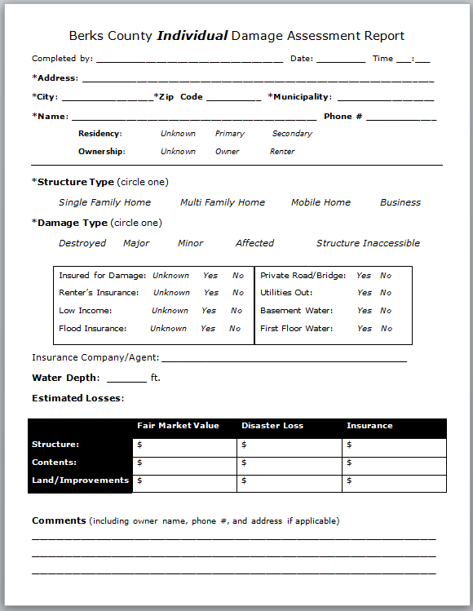
Individual Damage Assessment
Form similar to Crisis Track
  Ultimately, all reporting should and is done online
  Estimates will be automatically calculated in the online reporter

Slide 47
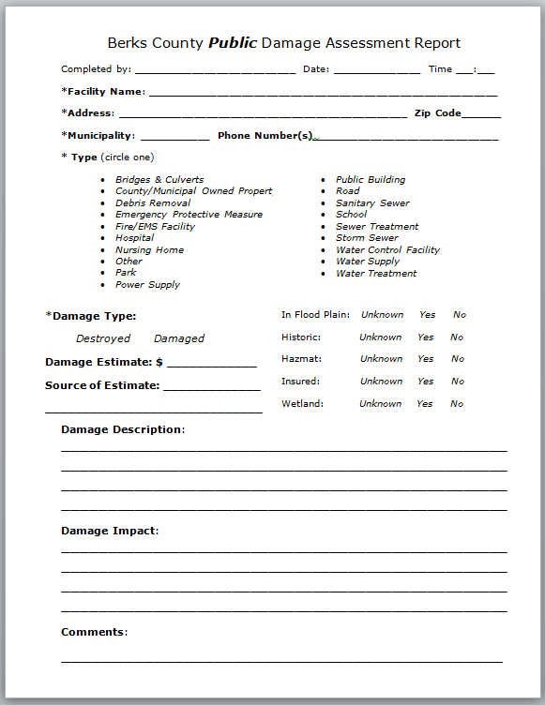
Public Damage Assessment
Form similar to Crisis Track
  Ultimately, all reporting should and is done online

Slide 48
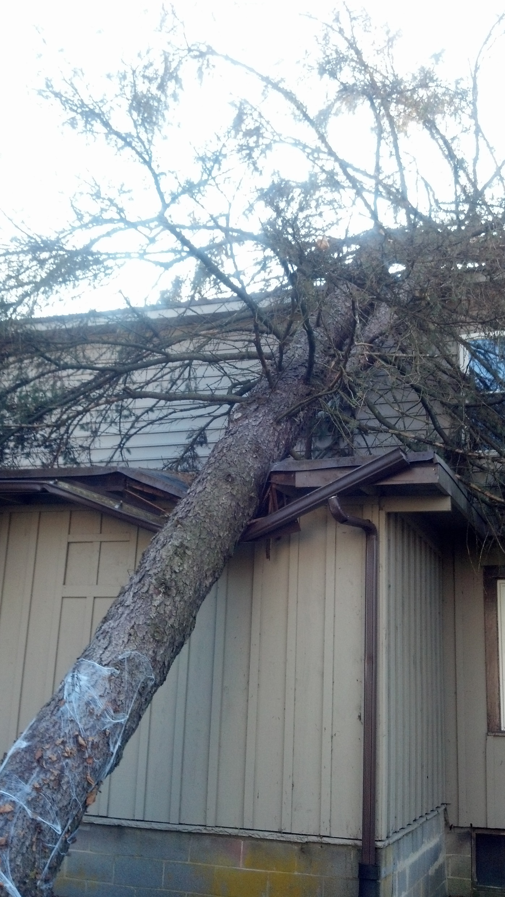
Reportable Damage
Individual Assistance
  Businesses
  Mobile Homes
  Multi-Family
  Single Family

Slide 49
Reportable Damage
Public Assistance
  Bridges & Culverts
  Fire/EMS/Police Facility
  Hospital
  Nursing Home
  Park
  Power Supply
  Non-profits
Public Assistance
  Roads
  Sanitary Sewer
  School
  Sewer Treatment
  Storm Sewer
  Water Control Facility
  Water Supply
  Water Treatment

Slide 50
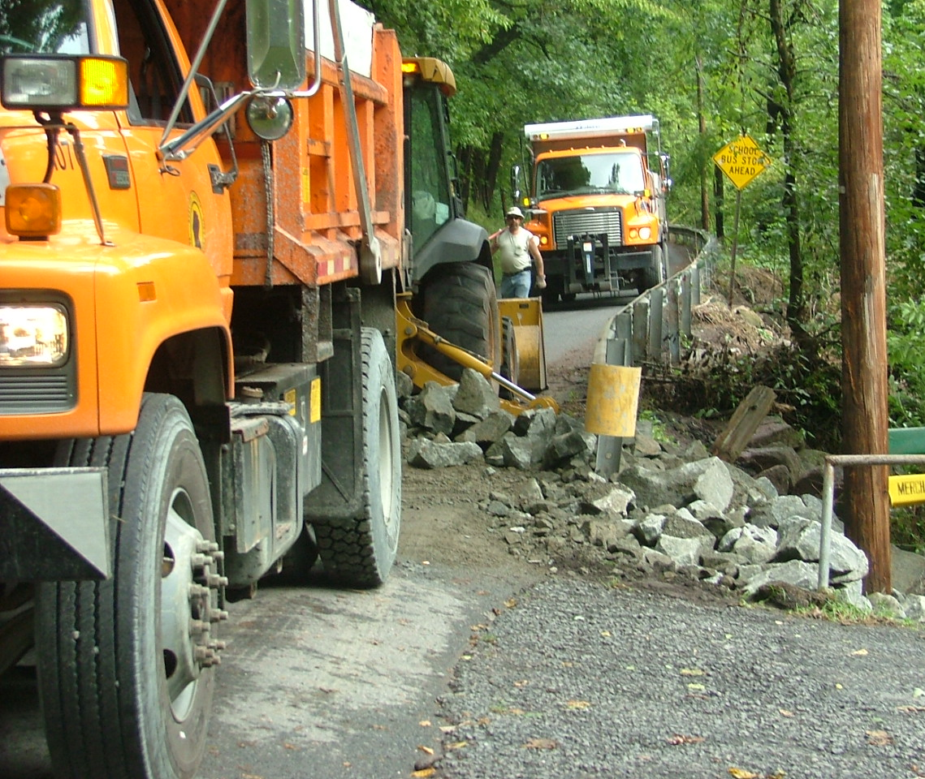
Public Assistance Eligibility
Provides funding for eligible applicants for:
  Emergency Work
  Permanent Restoration of disaster damaged facilities following a Presidential declaration of a major disaster
Notes:
Although this course covers the public assistance process, there are other methods assistance available; IA through FEMA, SBA Loans, FSA loans to farmers, etc.

Slide 51
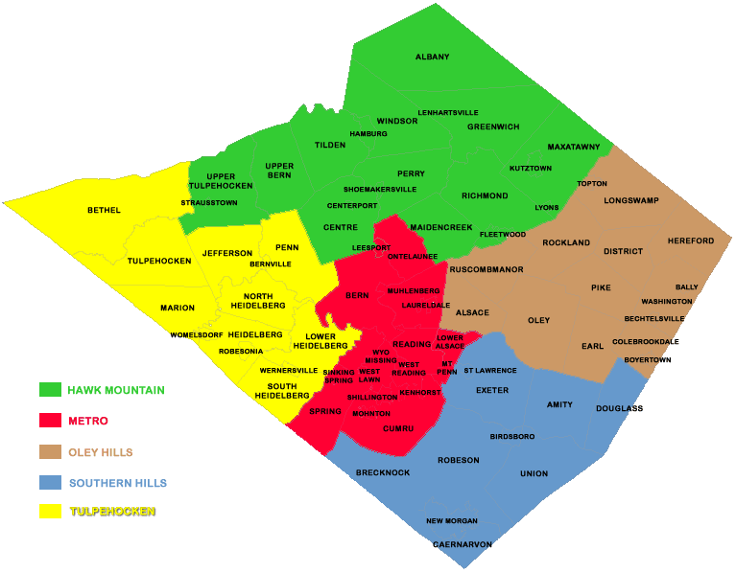
Eligible Applicants
State, County, Local Government
School Districts
Municipal Authorities
Private Non-Profit Organizations
  Critical Services
    Fire / EMS
    Medical Treatment
    Power, Water & Sewer Utilities
    Communication Systems
PNP Organizations
  Essential Services
    Community Centers
    Educational Facilities
    Homeless Shelters
    Libraries
Notes:
The municipal EMC needs to work closely with those PNPs in your municipality to ensure their damage is include in your municipal damage report.

Slide 52
Work Eligibility
To be eligible, the work must:
  Be disaster related
  Be located in the designated disaster area
  Be the applicant’s responsibility
  Not be funded by another federal agency
Notes:
Must be disaster related (damaged as a result of the incident)
You cannot get reimbursement for damage to PENNDOT property or a county owned bridge

Slide 53
Types of Work
Emergency Work
A. Debris Removal
B. Emergency Protective Measures
Permanent Work
C. Roads and Bridge Systems
D. Water Control Facilities
E. Public Buildings / Equipment
F. Public Utilities
G. Other (Parks, Recreation, Etc.)
Notes:
Reimbursement we receive from the FEDS may apply to all of these categories or only one; it depends on the impact the disaster had.

Slide 54
Debris Removal Activities
Clearance, removal, and/or disposal of items such as trees, sand, gravel, building components, wreckage, vehicles, and personal property.
Examples of eligible activities:
  Debris removal from a street or highway to allow the safe passage of emergency vehicles; and
  Debris removal from public property to eliminate health and safety hazards.
Notes:
Category A, or debris removal works encompasses the clearance, removal and/or disposal of items such as trees, sand, gravel, building components, wreckage, vehicles and personal property. In order for these actions to be eligible for reimbursement, they must;
● Eliminate immediate threats to life, public health and safety; or
● Eliminate immediate threats of significant damage to improved public or private property; or
● Ensure economic recovery of the affected community to the benefit of the community-at-large.
If debris removal activities are taking place, it is critical that the responsible parties maintain a comprehensive list of the expenses for this operation. This includes personnel hours (including overtime), hours of operation for equipment, equipment and consumables used, and any invoices or agreements.

Slide 55
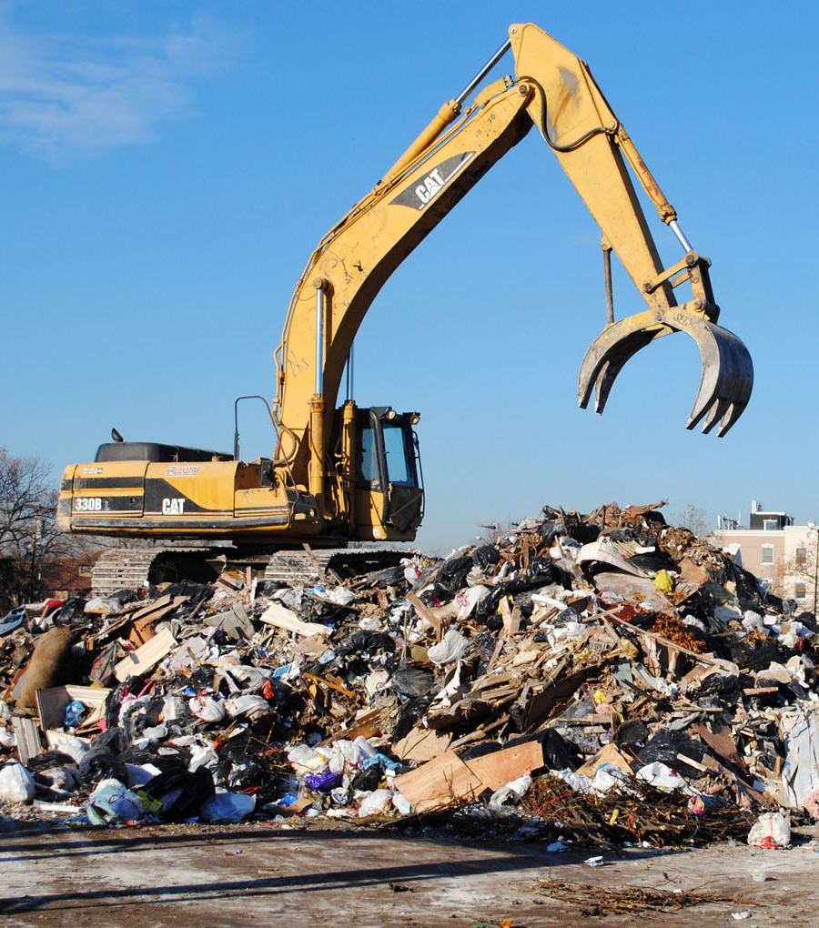
Debris Removal Activities
Document the following:
  personnel hours (including overtime)
  equipment hours
  equipment used (municipal owned or rented)
  Agreements / invoices
Notes:
Create an itemized list (they get picky) number of hours chainsaw was used by which person; how much fuel was used, etc.
Discuss FEMAs reimbursements rates; emphasize it is only used if they do not have any other reimbursement or cost rates.

Slide 56
Emergency Protective Measures
Emergency Protective Measures are actions taken by a community before, during, and following a disaster to save lives, protect public health and safety, or eliminate immediate threat of significant damage to improved public and private property through cost effective measures.
Examples of eligible activities:
  Search & Rescue Activities
  Demolition and removal of damaged property which poses a threat to life safety
Notes:
Category B, or emergency protective measures encompass those measures to save lives, and to protect public health and safety. In order for these actions to be eligible for reimbursement, they must;
● Eliminate or lessen immediate threats of significant damage to improved public or private
property through measures that are cost-effective.
Much like the debris removal activities, comprehensive records should also be kept for these actions.

Slide 57
Emergency Protective Measures
Document the following:
  personnel hours (including overtime)
  equipment hours
  equipment used (municipal owned or rented)
  Agreements / invoices
Notes:
Same key points as debris removal activities

Slide 58
Permanent Work
(Categories C – G)
Eligible permanent work:
  Must repair, restore or replace disaster-damaged facilities in accordance with regulations
  Must restore to pre-disaster design, capacity and function in accordance with applicable codes and standards
  Must be required as a result of the disaster
  May include cost effective hazard mitigation measures
Notes:
Categories C – G encompass those actions which repairs items damaged to pre-disaster conditions. In order for these actions to be eligible for reimbursement they must;
● Repair, restore, or replace disaster-damaged facilities in accordance with regulations
● Must restore to pre-disaster design, capacity and function in accordance with applicable codes
and standards
● Must be required as a result of the disaster
● May include cost effective hazard mitigation measures
For a comprehensive review of Category C – G work, consult the Federal Emergency Management Agency’s Public Assistance Applicant Handbook.

Slide 59
Participate in the Hazard Mitigation Planning
Attend Steering Committee Meetings
Complete Municipal Action Plans
Adopt Berks County HMP by resolution.
Every 5 Years

Slide 60
Continuity of Government
The principle of establishing defined procedures that allow a government to continue its essential operations in case of a natural or man-made disaster

Slide 61

Continuity of Government
Identify essential functions
Establish lines of succession
Define delegations of authority
Identify vital records
Document critical resources

Slide 62
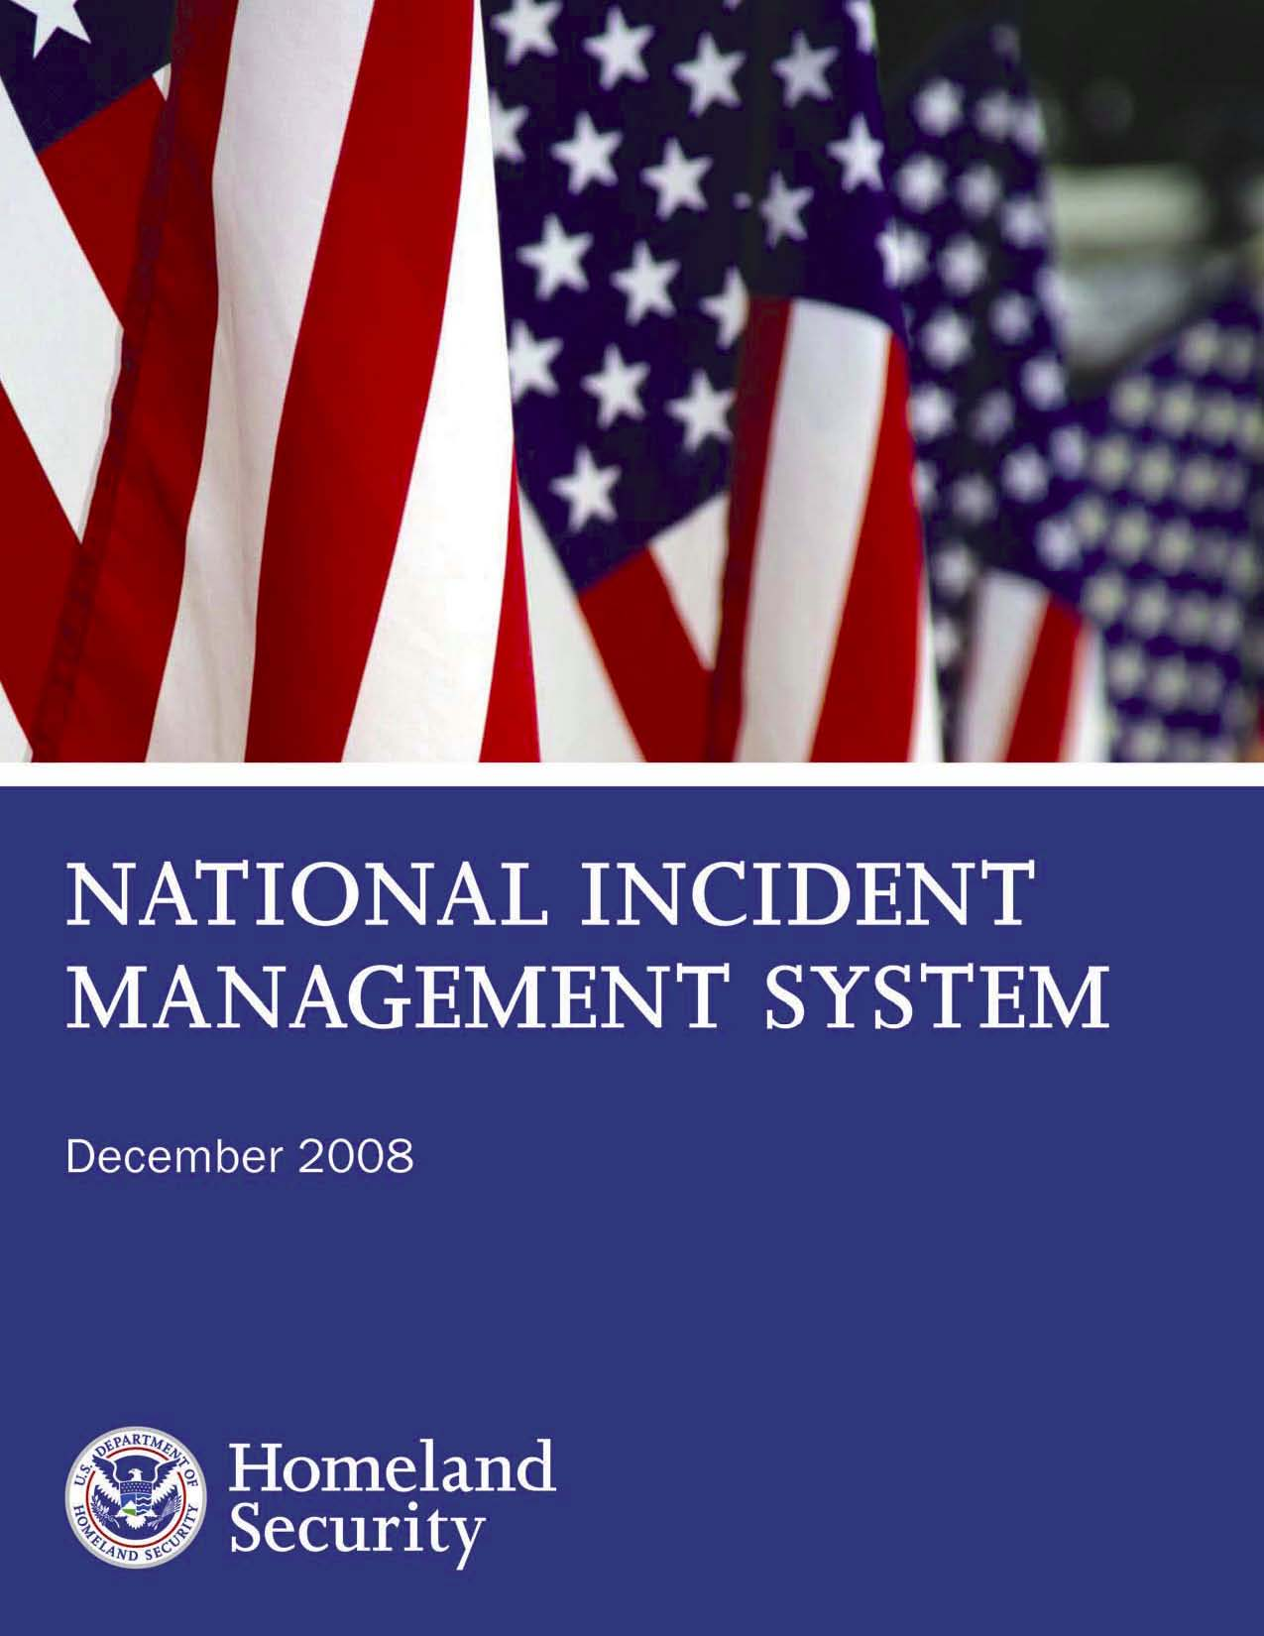
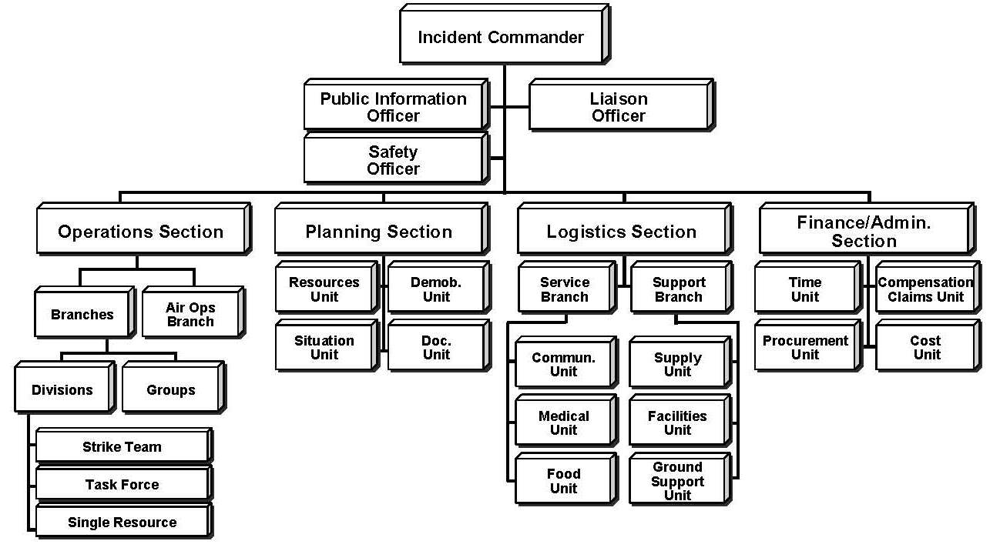
NIMS & ICS….IT’S MORE THAN TRAINING!!!!!

Slide 63
Purpose of NIMS
The National Incident Management System (NIMS) is a comprehensive system that “Provides a consistent nationwide approach to enable federal, state, tribal and local governments, non-governmental organizations (NGOs), and the private sector to work together to prevent, protect against, respond to, recover from, and mitigate the effects of an incident, regardless of cause, size, location or complexity” […] is a set of guiding core doctrines, concepts, principals, terminology, and processes that are meant to enable an incident management system that is not only effective, but that allows all entities to work together seamlessly as well.

Slide 64
Annual NIMS Implementation
Adoption
Preparedness
  Planning
  Training
  Exercises
Communications & Information Management
Resource Management
Command Management

Slide 65
NIMS Reporting
NIMS Data Collection Tool
  (FEMA/DHS Spreadsheet) Is the current tool used for reporting.

Slide 66
NIMS Reporting
PEMA
State Agencies
PEMA Eastern Area
PEMA
Central Area
PEMA Western Area
Regional Task Forces (3)
Counties (20)
Regional Task Forces (3)
Counties (23)
Regional Task Forces (3)
Counties (24)
Municipalities
Municipalities
Municipalities

Slide 67
NIMS Reporting Schedule
Compliance Reporting Quick Reference
Reporting Entity | Report Date | Report To
PEMA Area Offices | October 15th annually* | Pennsylvania NIMS Coordinator
State Agencies | October 15th, annually* | Pennsylvania NIMS Coordinator
Task Forces | N/A | N/A
Counties | October 5th, annually* | Area Office NIMS POC
Local Jurisdictions | September 30th, annually* | County NIMS POC
* Or the next business day if date falls on a weekend

Slide 68
What is ICS?
The Incident Command System
  Standardized, on-scene, all-hazards incident management concept.
  Allows its users to adopt an integrated organizational structure to match the complexities and demands of single or multiple incidents without being hindered by jurisdictional boundaries.

Slide 70
ICS Purposes
ICS helps to ensure:
  Safety of responders
  Achievement of tactical objectives.
  Efficient use of resources.

Slide 71
Legal Basis for ICS
HSPD-5: Management of Domestic Incidents
PPD-8: National Preparedness

Slide 72
ICS Training Levels training.fema.gov
IS-100: Introduction to ICS
IS-200: Enables personnel to operate efficiently during an event within ICS
IS-700: Introduction to NIMS

Slide 73
ICS Training Levels
training.fema.gov
IS-800: Introduction to concepts of National Response Framework
ICS-300: Advanced knowledge & application of the ICS
ICS400: Advanced for Command & General Staff.

Slide 74
FEMA Recommended Training for Elected & Appointed Officials
G–402: ICS Overview for Executives/Senior Officials
G-191: ICS/EOC Interface

Slide 75
Berks DES Run Cards
A Run Card is a form that is used to submit changes to Fire and EMS responses for a given response area(s) within a municipality.
  A complete run card is 8 pages and generally consists of 4 separate parts; Fire Responses, Fire Resource Lists, EMS Responses & Due Order, and the Authorization Page.

Slide 76
Berks DES Run Cards
A Properly completed Run Card should be submitted to DES by the designated Fire and EMS authority.
  Run Card authority varies between municipalities. Authority could be given to a single person such as a Fire/EMS Chief or EMC, or in some cases it is kept by the municipal governing body.

Slide 77
Berks DES Run Cards
Run Card authority is designated by Municipal Government
  Berks DES requires a Run Card Authorization Form to be on file for each Municipality in Berks.
  IMPORTANT NOTE: There are some municipalities in which the Fire Authority is different from the EMS Authority. Those situations require the authorization from BOTH parties to be considered a completed and fully authorized Run Card.

Slide 78
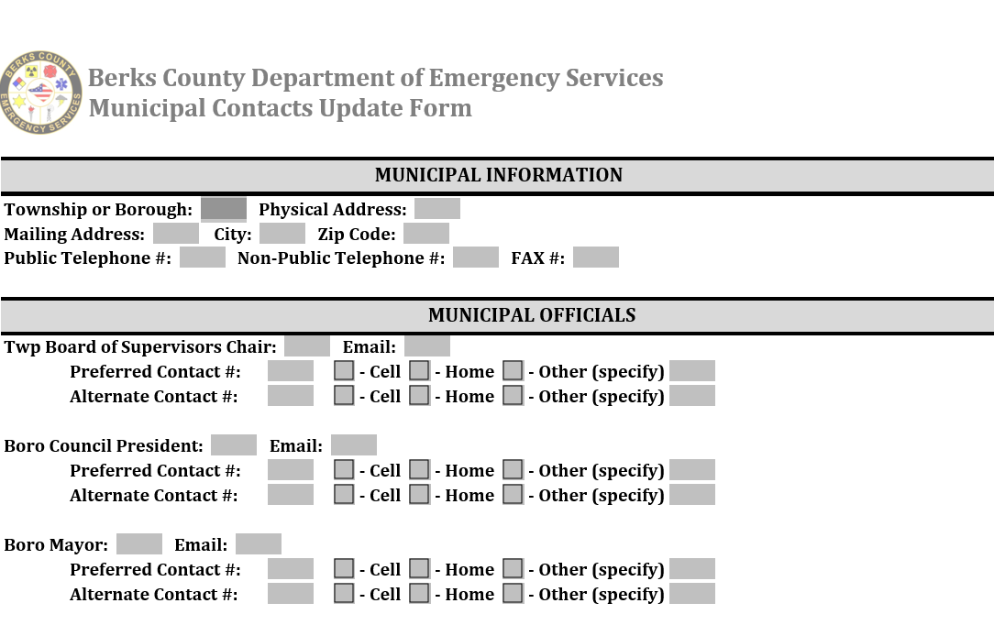
Current Contact Information

Slide 79
BerksDES@berkspa.gov

