Slide 1


BERKS COUNTY
MCD5000 DESKSET

Slide 2
Documentation Copyrights
No duplication or distribution of this document or any portion thereof shall take place without the express written permission of Motorola Solutions. No part of this material may be reproduced, distributed, or transmitted in any form or by any means, electronic or mechanical, for any purpose without the express written permission of Motorola Solutions.
2

Slide 3
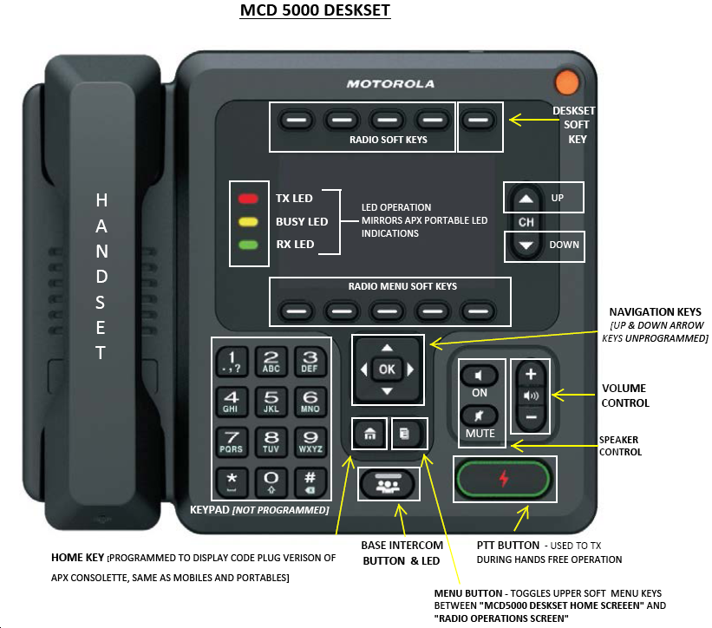

HOME KEY
3

Slide 4
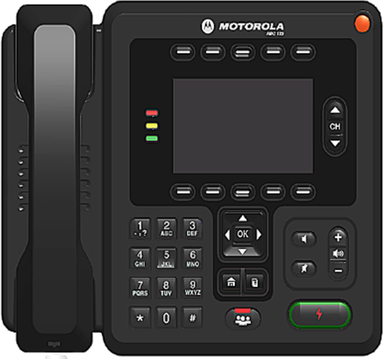
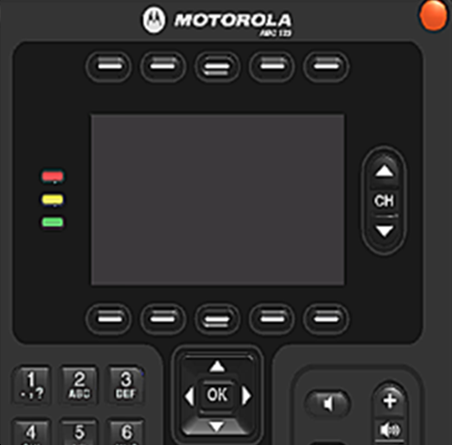
MCD 5000 Display and Radio Soft Menu Keys
Emergency Button
(Not Programmed)
The display is similar to the APX Portable Radio.
Radio Signal Strength
Indicator (RSSI)
High Power
Data Activity
Radio Zone Name
TG Name
Programmed Menu Keys
Supervisor
Emer
Disconnect
Radio Func.
More
POLICE NORTH
Dispatch A
ZONE
RSSI
INFO
REKY
Menu Select Items
Nuis Prfl Zone Scan ScnL
Mute Info Rcnt Colr Cnts
Myid
4

Slide 5

MCD 5000 Radio Soft Key Function Buttons
Radio Function Buttons
Toggles upper soft keys between “MCD5000 Deskset Home Screen” & “Emulated Radio Screen”
Menu – set the time & date,
display settings, performance,
VIP lines, etc.
Connect – connects &
disconnects the deskset from
the APX Consolette
Activity History – displays the
history log of the deskset
Quit - is used to lock the deskset
Deskset Status Bar
Deskset Soft Key
Menu
Connect
Activity Hist.
Quit
5

Slide 6
Login
On the login enter your user name and pin.
Press Radio softkey above Login to begin the user authentication process. Use backspace to correct typing errors of pin.
Note: There is a delay before the screen populates.
Note: The deskset locks for 5 minutes upon 3 consecutive incorrect entries of the pen.
3. Using Navigation keys, navigate to desired radio (if
applicable).
4. Press Deskset Menu key above Connect
Reconnect Deskset
Do not disconnect your deskset from the system. If you disconnect inadvertently follow this step to reconnect.
Press menu soft key above Connect.
The deskset is reconnected to the system and the disconnect menu function becomes available.
Deskset Menu (Yellow)
The deskset menu button access date/time, display, local, performance, VIP and versions
Press the Deskset Menu Button
Use navigation keys to navigate to selected option.
Press OK
Menu Button
Toggles upper soft keys between "MCD 5000 Deskset Home Screen" and "Radio Operations Screen”.
Set Volume
Press the Volume Control up/down button to increase or decrease volume.
Select a Channel/Talkgroup
Press the Channel up/down button to the required channel. The new channel name will appear on the display.
Select a Zone
Press the Radio softkey below ZONE.
Press the Navigation keys to locate the required zone.
Press the PTT (Push-to-Talk) button briefly to confirm and select the zone. The zone is not selected until you complete this step. The new zone name will appear on the display.
Home Button
Press the home button to return to the home screen.
Press and hold the Home Button to return to the home talkgroup/channel.
Transmit and Receive
Using microphone on deskset unit:
Press the PTT button on the deskset and begin speaking toward the unit, release to listen.
Using handset:
Lift handset.
Press the PTT on the underside of the handset and begin speaking, release to listen.
When finished place handset back onto deskset.
Mute
Press and release the ALL MUTE button to mute the speaker, allowing the deskset user to mute all received audio.
The LED inside the All Mute button turns red indicating Mute.
Pressing any button will remove the deskset from All Mute state.
6

Slide 7
Programming a Scan List
To add a talkgroup/ channel:
1. Press the Navigation Keys until SCAN is displayed.
2. Press and hold the button below SCAN
Indicator flashes, indicating the Program/View mode. You
will also see SEL, DEL, and RCL displayed as possible
choices.
3. Press either side of the 4-way navigation button to scroll
through the available zones and/or turn the talkgroup/channel
select knob to scroll through the talkgroups/channels within each
zone.
4. When you reach a talkgroup/channel that you wish to add to the scan list, press the button below SEL to add the talkgroup/channel to the scan list. The scan indicator ( ) is displayed indicating that the talkgroup/channel is a member of the scan list.
5. Press the HOME button to exit scan list programming and return
to normal operation.
To delete a talkgroup/channel:
1. Press and hold the Radio Softkey below SCAN.
2. Repeatedly press the button below RCL to scroll through the
scan list members.
3. When you reach a talkgroup/channel that you wish to delete from the scan list, press the button below DEL to delete the talkgroup/channel from the scan list.
4. The scan indicator disappears indicating that the
talkgroup/channel is no longer a member of the scan list.
5. Press the HOME button to exit scan list programming and
return to normal operation.
Turning Scan On/Off
1. Press the Navigation Keys until SCAN appears.
2. Press and release the button below SCAN to start scanning.
The Scan indicator ( )lights and a list of talkgroup/channels are scanned for activity.
1. To turn scan off, press the button below SCAN again.
The scan indicator disappears.
Nuisance Delete
Temporariy delete a talkgroup/channel from scan list. When the radio is locked onto the talkgroup/channel to be deleted:
1. Press the MENU button directly below NUIS.
2. Press the MENU button directly below DELETE.
Restoring a Nuisance Channel/Talkgroup
Turn Scan off and then on or change modes.
Responding to an Emergency Alarm/Call
1. From the Home Screen, press the radio softkey ACK
2. Press Menu Button
3. Press Deskset menu button above EMER
Use the Navigation Keys to highlight the emergency ID line.
Press Radio Softkey Clear to clear the emergency.
Press the Radio Softkey Close, to return to the home screen.
7

Slide 8
INFO
Press the Radio Soft Key below INFO.
Press the left or right navigation key to view RADIO INFO, IP INFO, or CONTROL MAP.
Press the menu soft key below SEL.
Press the left or right navigation key to view content.
Press the menu select below BACK.
Press menu select below EXIT.
Site Trunking
You will be notified by a field user if their radio is in SITE TRUNK. During this system failure mode follow your department’s protocol of operation. During site trunking dispatch consoles and field users cannot communicate. Dispatch communications will need to be handled from the DO deskset.
Keep your zone/channel assignment list next to the deskset so you can see the order of your zones/channels.
Use the zone change feature to get to the appropriate simulcast cell that is in site trunking. SITE TRK will appear as part of the zone name. You will know if the zone is in site trunking because a banner on your display will state SITE TRUNKING.
When the Site Trunking failure ends return to your normal operation by selecting the zone/channel assignment you typically use for communications.
Adjust Display Intensity
1. From the home screen press and release MENU, SETTINGS
Use the navigation keys to select Display. Press and release
the OK.
2. Use the up and down arrows of the Navigation Keys to
move between the brightness and contrast sliders.
3. Use the left and right arrows of the Navigation Keys to set
brightness and contrast intensity or use Default to return all
values to factory default settings.
4. Press and release Apply to confirm your settings and return
to the Home screen or press Cancel to cancel changes and
return to the Home Screen.
8

